Slide 1
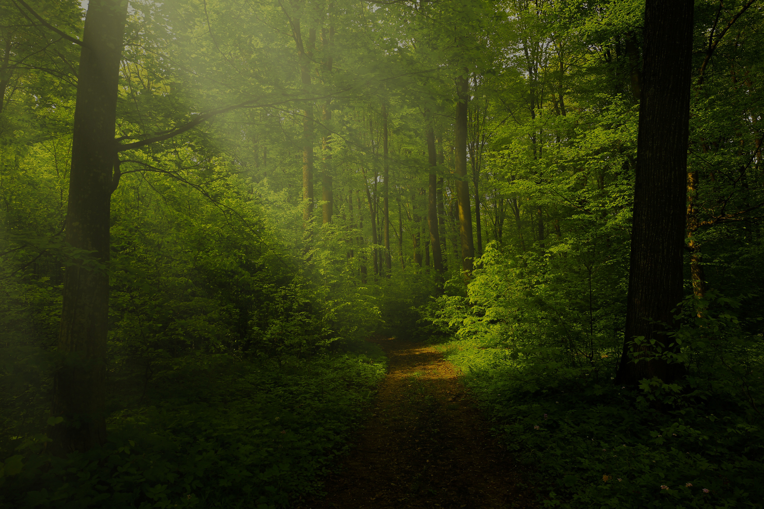
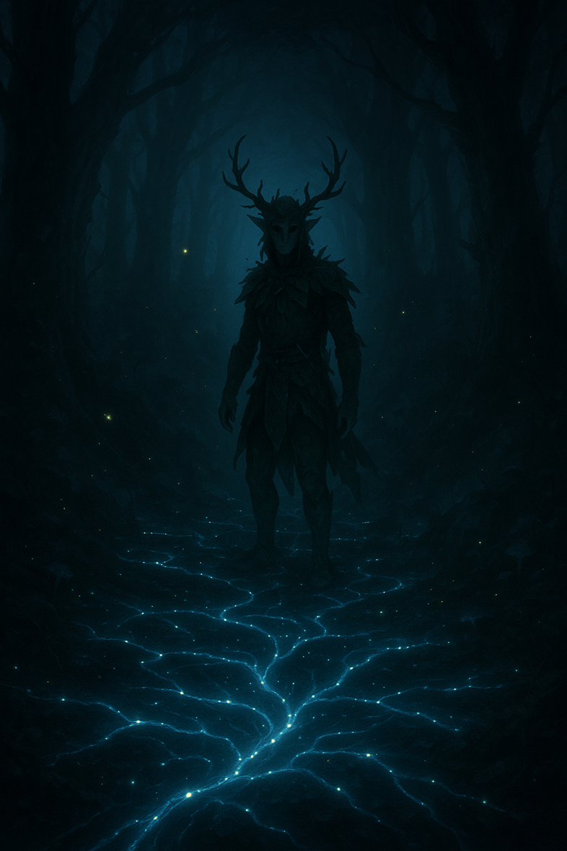
UDRUM & FOREST
“Save the forest and reconnect the soul of the forest.”

Slide 2
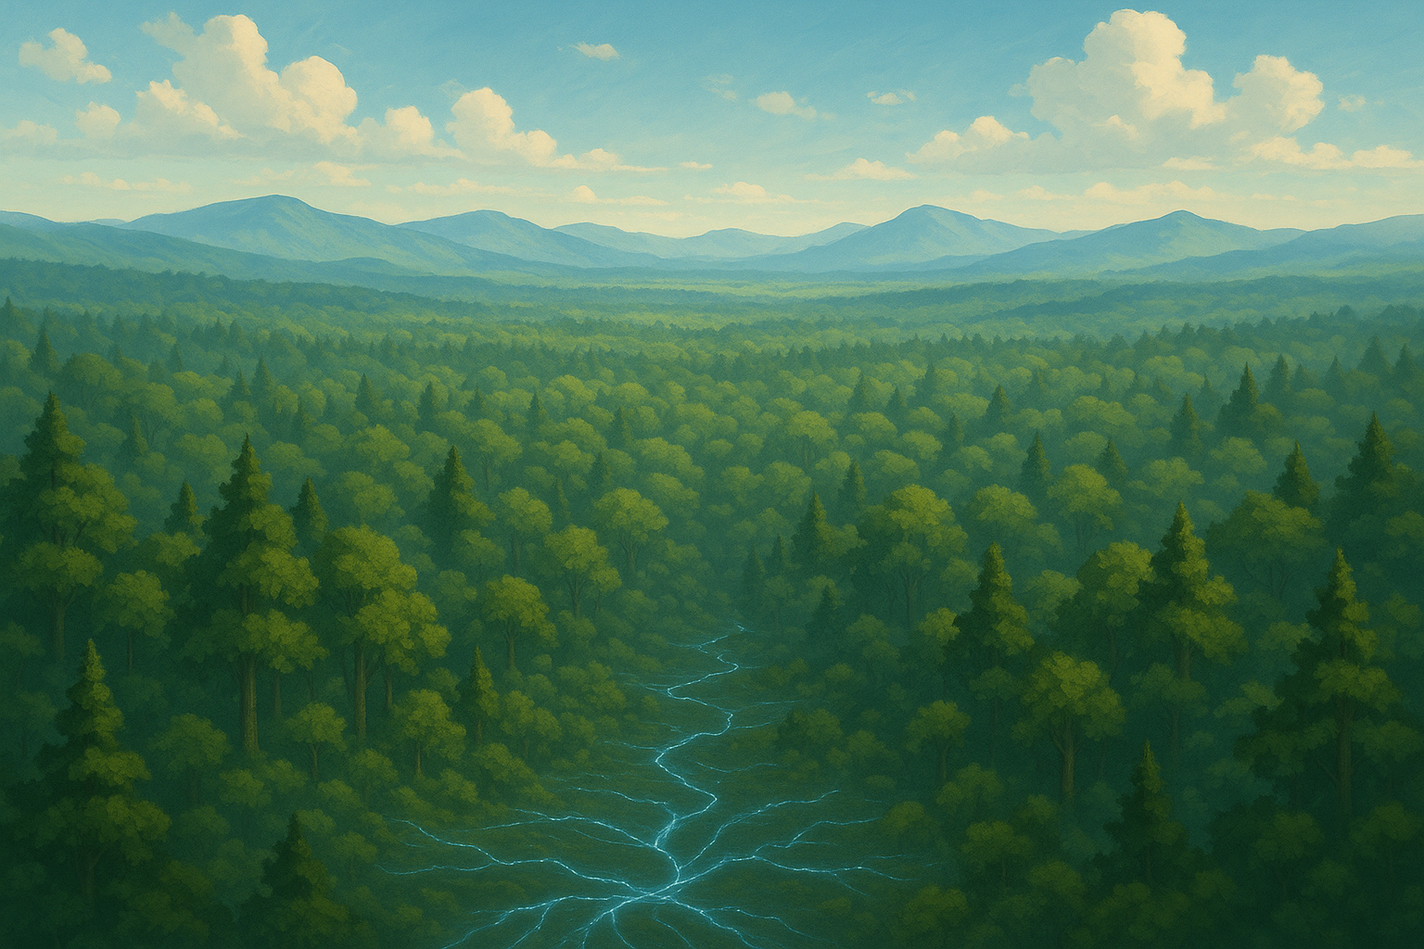
OVERVIEW
<< Stay connected with the forest and save it from danger >>
Udrum, a sylvan creature, is the guardian of the forest who will defend his environment from unconscious actions of man.
inspired by Trentino folklore

Slide 3

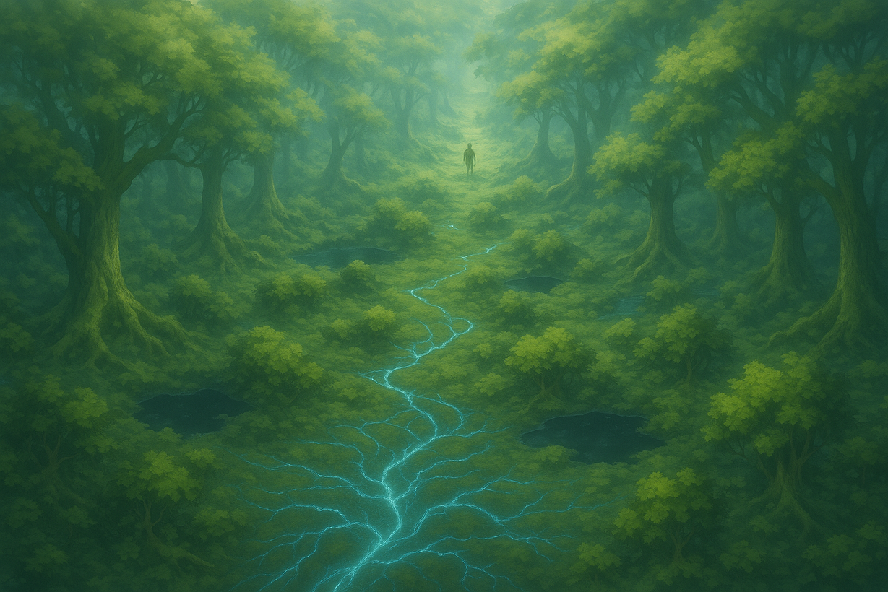

GAME SHEET
Technical data sheet
Genre
Open World Exploration Adventure in first person camera with Environmental Puzzles
Platform
PC-windows os
Game Mode
Single Player
Main Tech
UNITY
Key Market
UE
Languages
IT + EN
Business Model
Buy to Play
Price
19.90 Euro

Slide 4
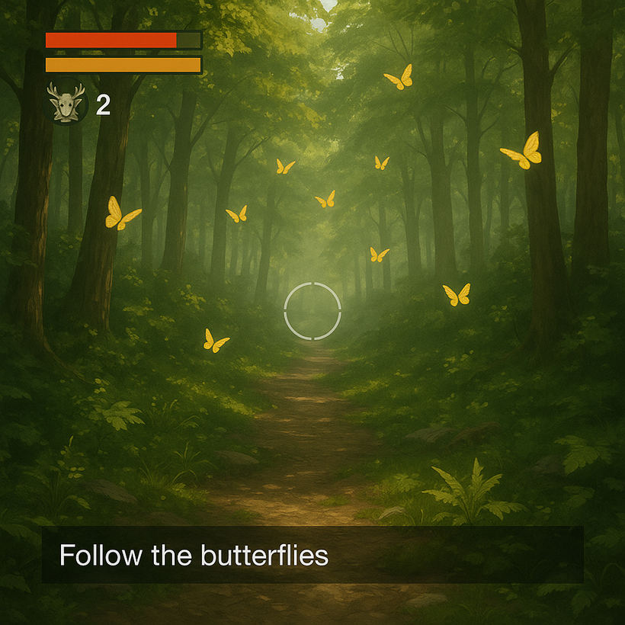
GAME CONCEPT
First-person gameplay, featuring environmental puzzles and narrative missions. The player moves freely through the forest, where every action consumes energy or stamina, encouraging a thoughtful and strategic approach.
• Purification – Interact with mycelium to cleanse corrupted areas.
• Liberation – Rescue trapped animals through environmental puzzles.
• Skill Check – Timed events that require precision to overcome environmental challenges.
• Mycelic Perception – Sensory modality that reveals hidden connections and paths.
• Natural Guidance – Butterflies by day and fireflies by night show the way.
• Ecological Morale – Every action visually and audibly influences the game world.
• Move Objects – You can grab and move object in the enviroment for overcome obstacles and continue in your mission.

Slide 5
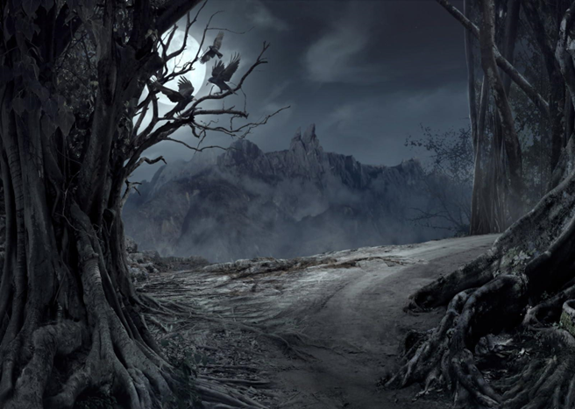

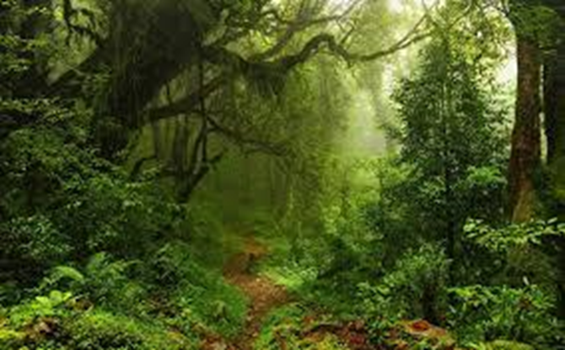
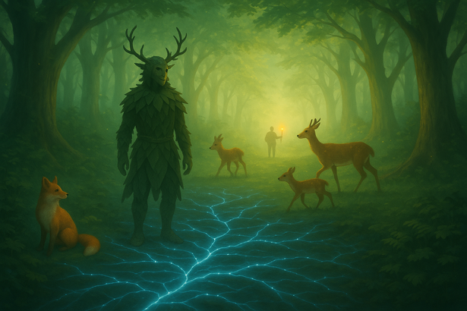
MORE THINGS
We are in a far land in Northern Europe, in a forest where a sylvan creature named Udrum lives, guardian of the forest will defend its environment at all costs, threatened by the unwitting actions of man.
Through the mycelial network (the forest's underground communication system), the protagonist senses the forest's pain and is guided by fireflies at night and butterflies during the day to reach the point of interest at the moment.
All events are narrated through a system of messages that appear and scroll horizontally from right to left at the bottom of the HUD.
Missions can be rescue missions or mitigation actions to restore the natural balance, which become gradually more difficult.
By your TELECINESIS POWER you can move objects for remove obstacles from your way or for solve environment issues.
As the game progresses, by saving the forest creatures
and restoring the forest's balance through reclamation work,
the setting becomes more lush and bright with increasingly
active animals.

Slide 6
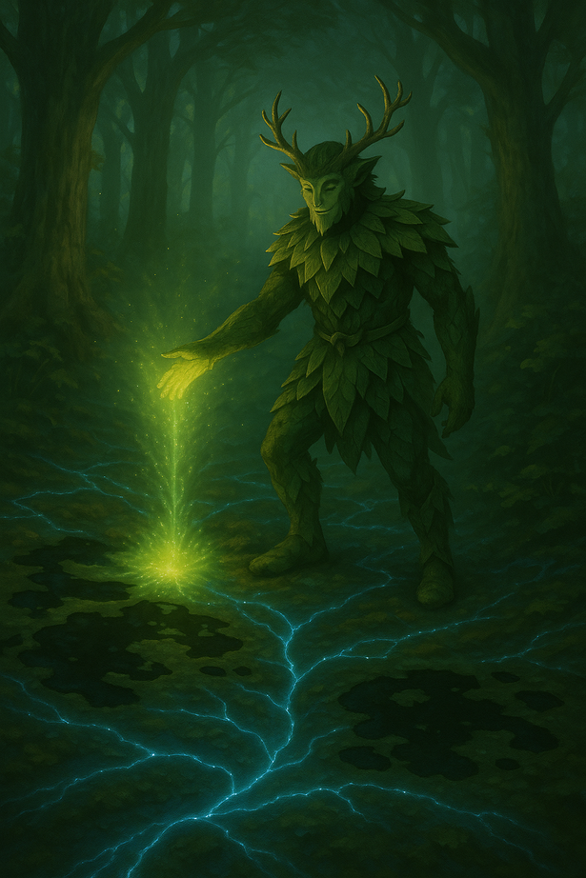
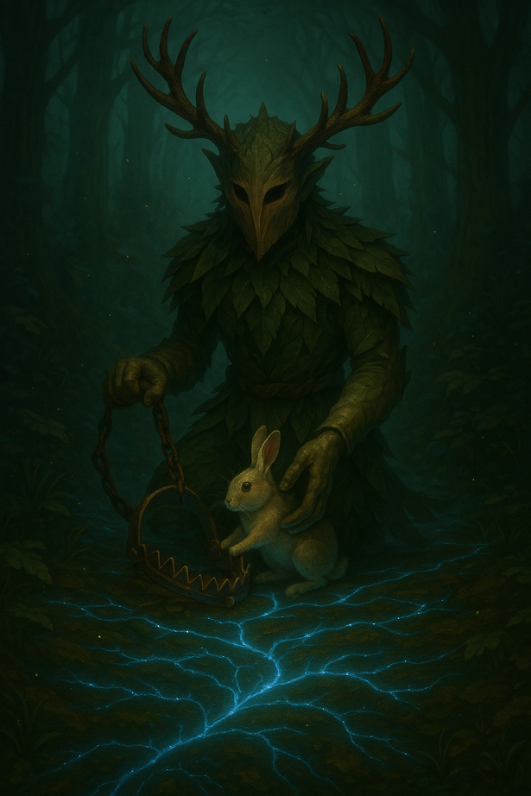
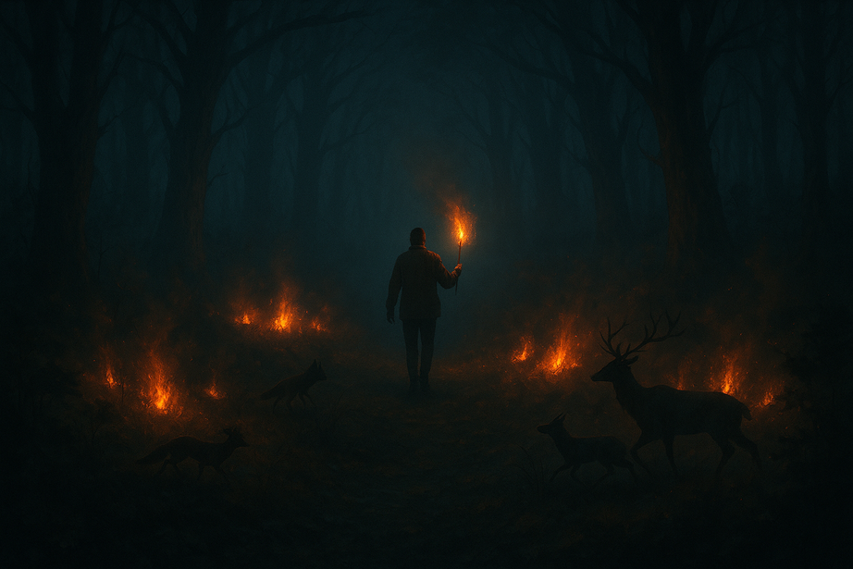
ENVIRONMENTAL PROBLEMS
protect the forest from fires
clean up the forest from polluted pools
free animals from traps

Slide 7
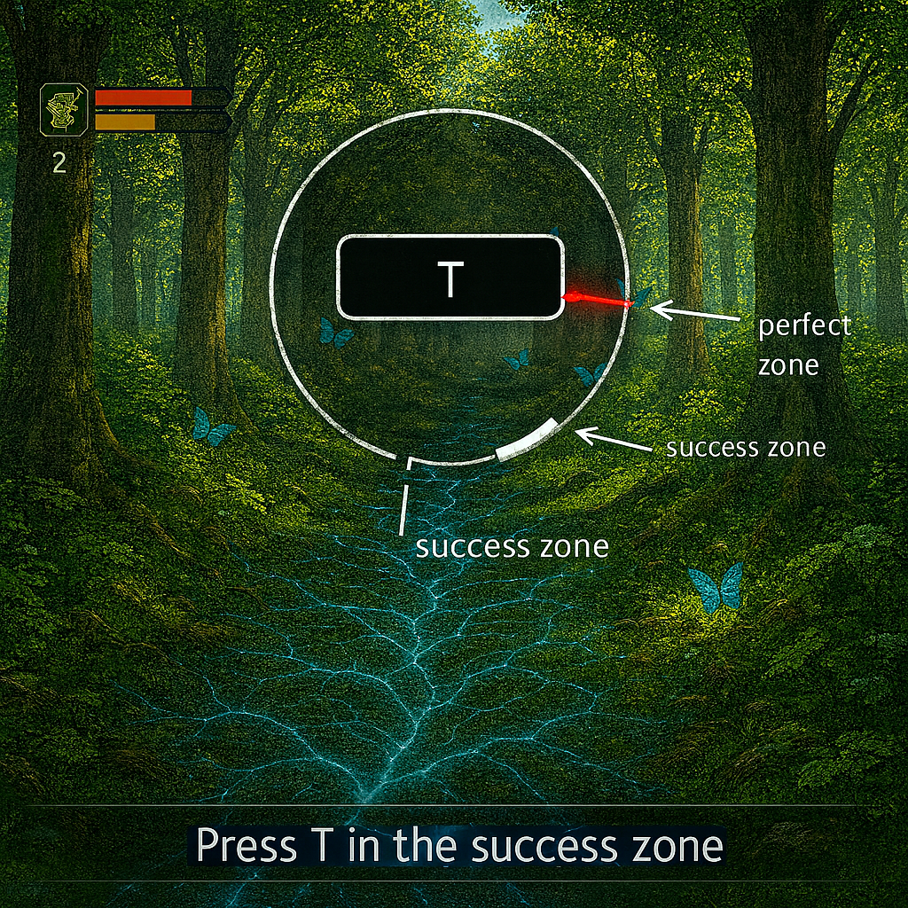
GAMEPLAY
SKILL CHECKS allow the player to solve environmental problems
To win you need perform skill check 3 times

Slide 8
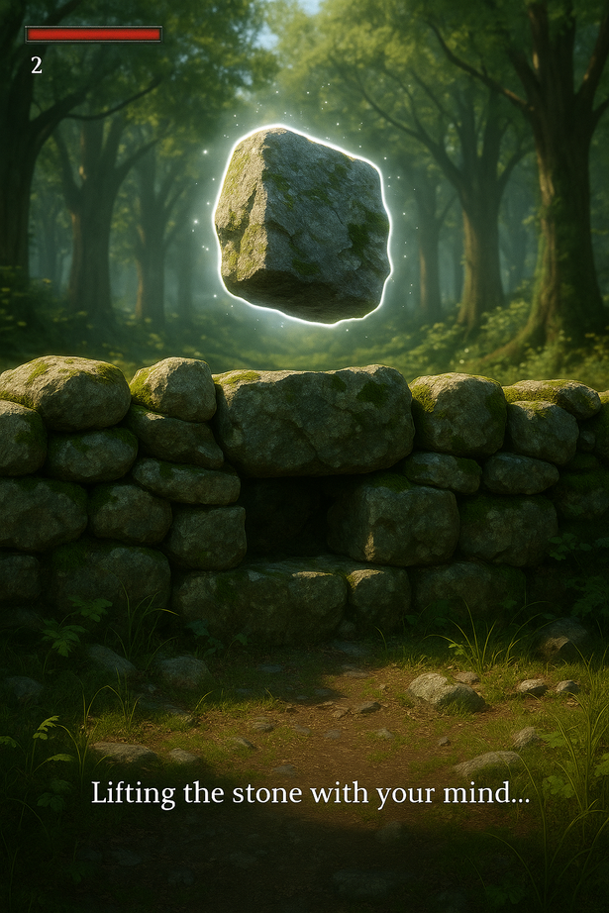
MECHANICS
you can grab and move object in the enviroment using telecinesis; you can grab object by pressing button ‘O’ when interactable object is in crosshair.
you can rotate object in the enviroment by hold the right mouse button and moving mouse.
you can shoot object in the enviroment by pressing left mouse button.
by this Power you can resolve environment issues too.

Slide 9
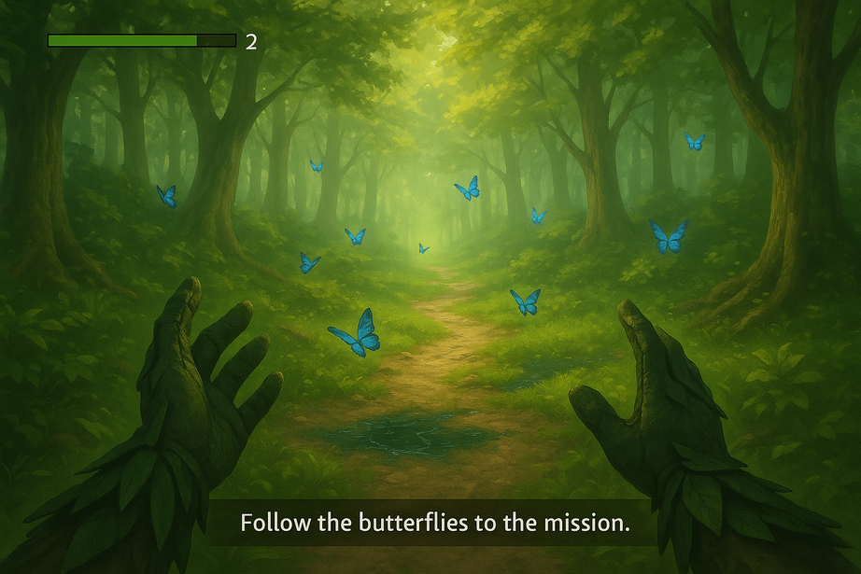
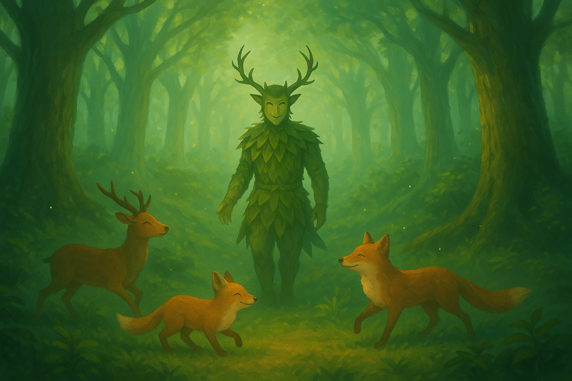
GAME LOOP
START
FOREST MYCELIUM NOTIFIES PROBLEM TO PLAYER
Reduce paper waste
FOLLOW BATTERFLIES OR FIREFLIES
PERFORM 3 SKILL CHECKS
success ??
yes
no
RESTART
YOU LOST

Slide 10
PILLARS
1. Guided Exploration (Diegetic Navigation)
Why: The player must reach Points of Interest (POIs) without intrusive UI or mini-maps.
How: Use butterflies (day) and fireflies (night) as natural guides; glowing mycelium threads subtly indicate direction.
2. Focus-Based Skill Checks
Why: Adds short, tense, skill-based interaction moments that fit the theme of precision and care.
How: Single-button input (“T”), visible success zone, difficulty scales with arrow speed and window size.
Success Metric: Average success rate: 70% at early levels → 55% at advanced levels; clear audiovisual feedback for success/failure.

Slide 11
KEY SELLING POINTS
Diegetic Guidance, No HUD Clutter
Butterflies, fireflies, and glowing mycelium replace intrusive maps and
markers. Immersion and navigation become part of the natural world.
Poetic, Atmospheric World Design
Inspired by forest folklore and bioluminescent ecosystems, the visual and
audio direction creates a sense of wonder and melancholy.
Core Moral / Message
Short version (for a tagline): Respect the forest, and it will guide you back
to balance.
there are the possibilities to have funds or sponsorships from green organizations or european institutions.
the strong point is the social and educational purpose that a game like this can have while respecting the environment.

Slide 12

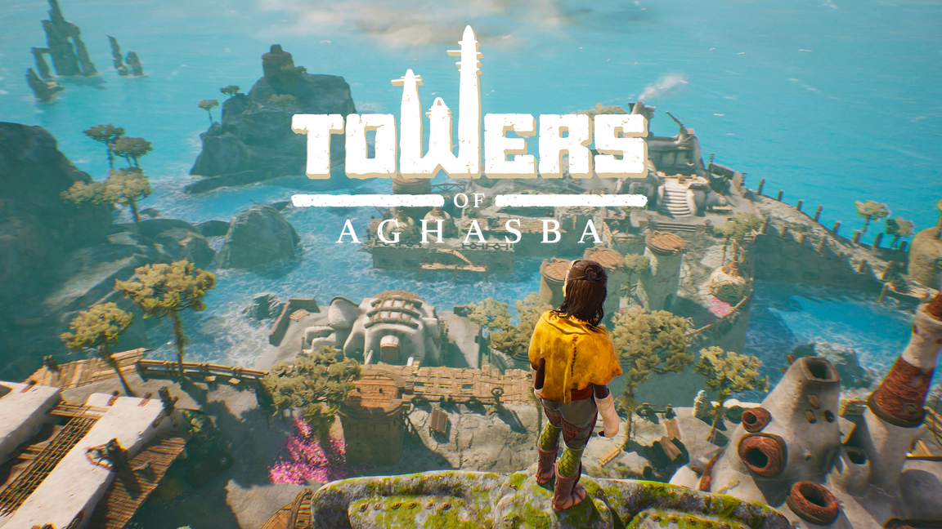
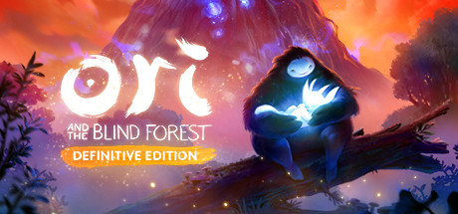
CREATIVE MIX
ispired by various
legends of Nordic folklore.
16,79€
Open World Game in the natural environment
young hero save the forest that was dying
19,99€
28,99€

Slide 13
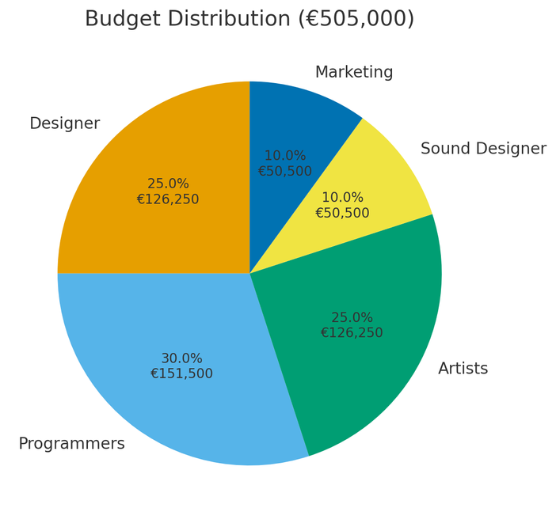
FINANCIAL PROJECTION
BUDGET : 505 000 €
GAME PRICE: 19,90 €
DESIGNER : 25%
PROGRAMMERS : 30%
ARTIST: 25%
SOUND DESIGNER: 10%
MARKETING : 10%
BREAK-EVEN: 36300 copies

Slide 14
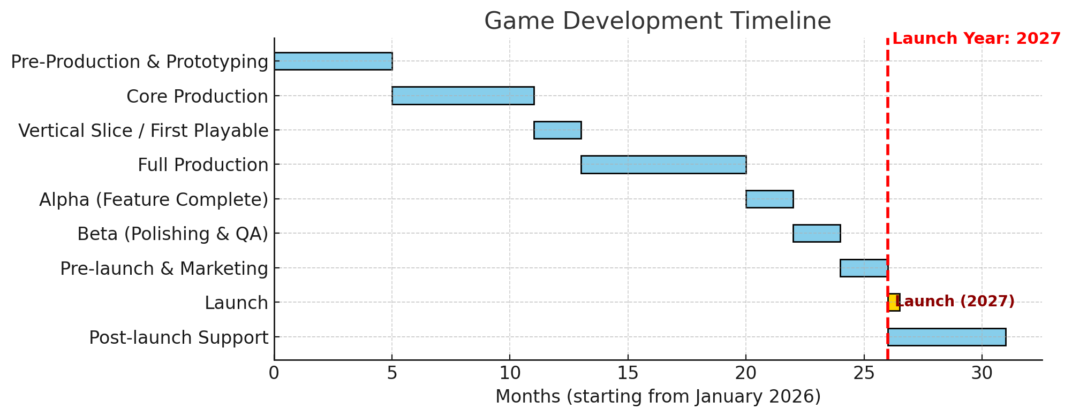
TIMELINE

Slide 15
TEAM
GAME DESIGNER
To be recruited
PROGRAMMERS
Andrea Fraboni
To be recruited
ARTISTS
To be recruited
To be recruited
SOUND DESIGNER
To be recruited

Slide 16
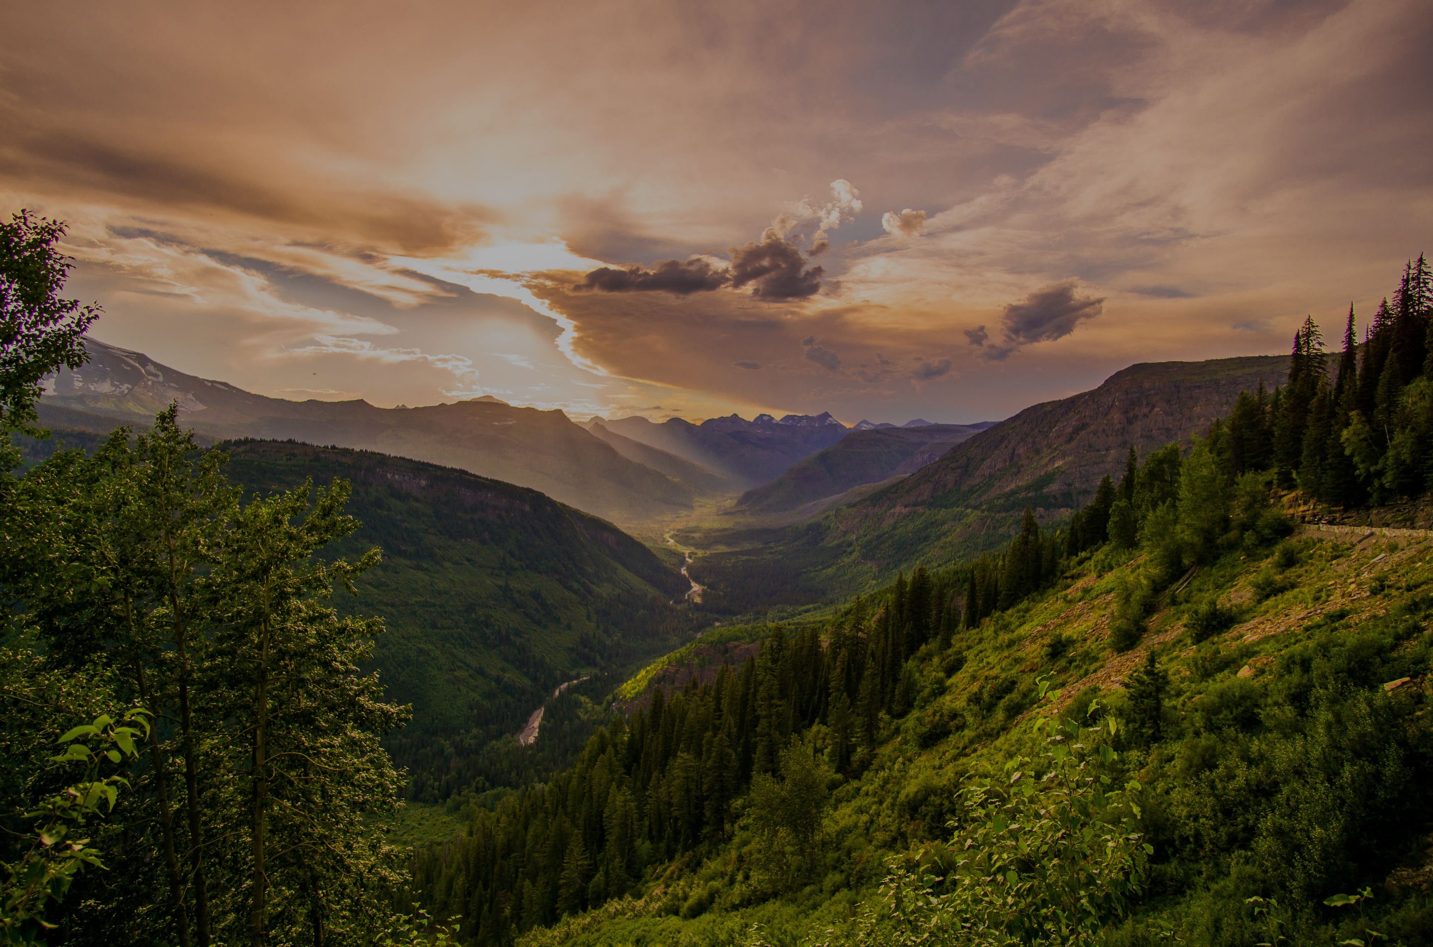
THANK YOU
Let’s keep our Earth green and alive

